Slide 1
CSCI 6521 Advance Machine Learning I Supp. Material: kNN & Curse of Dim.
Md Tamjidul Hoque

Slide 2
Simple Approach 2: Nearest Neighbors or kNN: kNN Applied to Housing dataset
Figure: Area versus house price. Schematic outline of predicting the price for area x_{q} using the k-nearest neighbor method when k=3
Notes:
kNN => k-nearest neighbor (method)

Slide 3
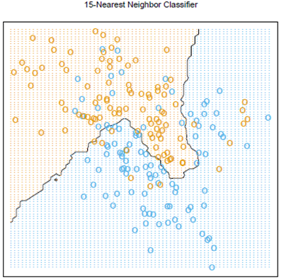
…Simple Approach 2: Nearest Neighbors
Idea: Use those observations in the training set that are closest to the given input
N_{k}(x) is the set of the k closest points to x is the training sample.
Average the outcome of the k closest training sample points
Fewer training points are misclassified.
(2.8)
Figure 2.2. The classes are coded as a binary variable (BLUE = 0, ORANGE = 1) and then fit by 15-nearest-neighbor averaging as in equation (2.8). The predicted class is hence chosen by majority vote amongst the 15-nearest neighbors

Slide 4
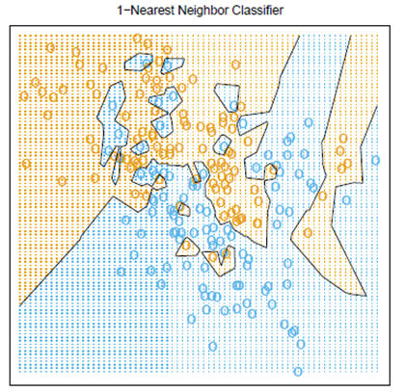
Simple Approach 2: Nearest Neighbors
For 1-NN, there is zero misclassification.
Figure 2.3. The classes are coded as a binary variable (BLUE = 0, ORANGE = 1), and then predicted by 1-nearest-neighbor classification
Notes:
Voronoi tessellation of the training data. Each point x_{i} has an associated tile bounding the region for which it is the closest input point

Slide 5
Curse of Dimensionality / Local Methods in High Dimensions
So far we have seen 2 extremes:
the stable but biased linear model and
the less stable but apparently less biased class of k-NN estimates.
It would seem that with a reasonably large set of training data, we could always approximate the theoretically optimal conditional expectation by k-NN averaging, since we should be able to find a fairly large neighborhood of observations close to any x and average them.
This approach and our intuition breaks down in high dimensions, and the phenomenon is commonly referred to as the curse of dimensionality. Let us see, how!?

Slide 6
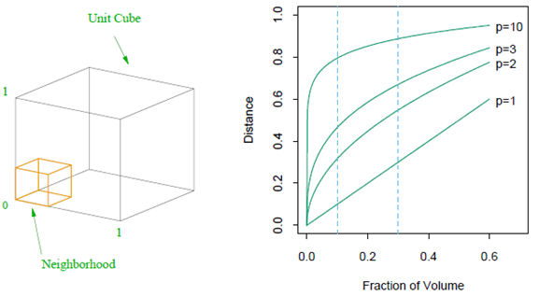
Curse of Dimensionality / Local Methods in High Dimensions
Consider the nearest-neighbor procedure for inputs uniformly distributed in a p-dimensional unit hypercube.
Suppose we send out a hypercubical neighborhood about a target point to capture a fraction r of the observations.

Slide 7
Curse of Dimensionality / Local Methods in High Dimensions
In ten dimensions e₁₀(0.01) = 0.63 and e₁₀(0.1) = 0.80, while the entire range for each input is only 1.0.
So, to capture 1% or 10% of the data to form a local average, we must cover 63% or 80% of the range of each input variable, respectively.
Such neighborhoods are no longer “local.”
Reducing r dramatically does not help much either, since the fewer observations we average, the higher is the variance of our fit.

Slide 8
Curse of Dimensionality and Statistical Model
If the dimension of the input space is high, the nearest neighbors need not be close to the target point, and can result in large errors;
If special structure is known to exist, this can be used to reduce both the bias and the variance of the estimates.

